Slide 1




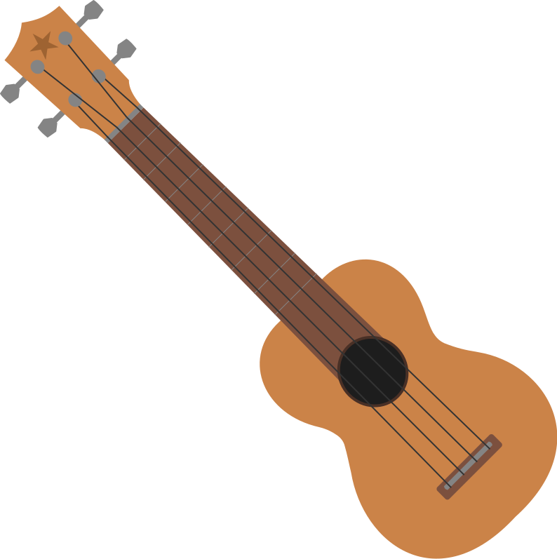
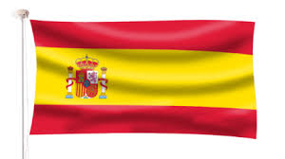
Swans Year 3 & 4 Summer 1 1
Maths
Learn, Love and Flourish with God
SUMMER 1 2025/2026
Swans Class Medium Term Plan
We will be Learning….
English
Fractions We will be continuing our work on fraactions including fractions of amounts.
Mass, capacity and time.
. We will use standard units to measure. W will have a focus on telling the time.
YR4 children will be focusing on the speed and recall of times tables for Mtc
Weslandia by Paul Fleischman
We will be continuing to extend our writing skills using fronted adverbials to vary our sentences. We will learn about paragraphs and retell the story. We will continue our focus on spelling with weekly spelling on Spelling shed and handwriting using Letter join.
PSHE
RE
Health and well being
In this unit, pupils will explore health and wellbeing by learning how relaxation and stretching affect the body. They will reflect on their strengths, feelings and experiences, including making mistakes, setting boundaries and belonging to communities. Pupils will identify what makes them happy, set goals, and understand what they can and cannot control.
Why do Muslims call Mohammad the ‘Seal of the Prophets’? Explain that Muslims believe Muhammad was a messenger of God and the last prophet and recall something about his life. Describe what Muslims might learn from a story about Muhammad’s life.Describe some different ways Muslims show their beliefs about Muhammad such as in art, calligraphy or design.
Why are rainforests important to us?
Focussing on the link between biomes and climate, locating the Amazon rainforest and explaining how the vegetation in a tropical rainforest is defined by the two Tropics. Investigating the physical features and layers of the Amazon rainforest, considering how plants adapt to these conditions. Learning about the people who live in the rainforest, discussing the impact of human activity locally and globally.
.Geography
Computing
Science
Data handling (Investigating Weather) (4)
Researching and storing data using spreadsheets, designing a weather station which gathers and records data and learning how weather forecasts are made. Children use tablets or digital cameras to present a weather forecast.
Plants (3)
Identify and describe the functions of different parts of flowering plants: roots, stem/trunk, leaves and flowers Explore the requirements of plants for life and growth (air, light, water, nutrients from soil, and room to grow) and how they vary from plant to plant Investigate the way in which water is transported within plants Explore the part that flowers play in the life cycle of flowering plants,
PE
We will have PE sessions in the village hall weekly
Please ensure you have your PE kit in school everyday and that it is named!. We will be swimming at Arundel Lido
Music
We will be learning to play the Ukelele with WSCC music service.
Our sessions will be on Wednesdays 11.00- 11.45
We will be learning about singing, music notation and how to perform to together.
Homework
Craft and design: Fabric of nature (Rainforest starting point) 4
We will use subject vocabulary to describe objects, images, sounds, and William Morris’s work. They will create drawings, mood boards, and patterns, exploring colour, repetition, and design. Using sketchbooks, pupils will evaluate ideas, follow instructions to create repeating patterns, and develop designs for products, showing confident, creative use of materials.
Times tables Spellings and reading
We will have spellings to learn each week linked to our phonics scheme. These will be set on Mondays and quizzed on the .following Monday.
We will be reading daily in school and you are expected to continue reading at home; using your reading record book to record this.
Spanish
We will be learning vocabulary and phonics to help us speak in Spanish. Our theme is – RainForests

