Slide 1

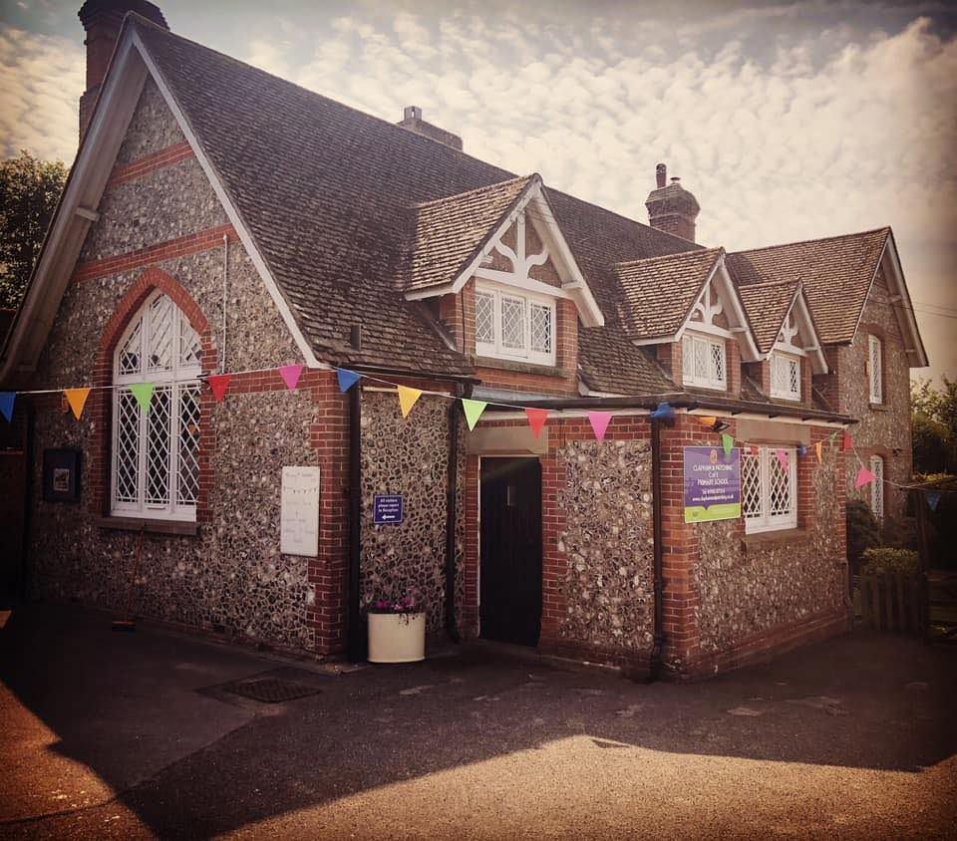
‘Learn, Love and Flourish with God’
A warm welcome to Clapham and Patching CofE Primary School

Slide 2


Our Vision:
We believe that a happy child is a successful one.
Our vision is to develop confident, creative, kind and responsible individuals who aspire to achieve their full potential. We do this by providing a welcoming, happy, safe and supportive learning environment, in which everyone is equal and all achievements are celebrated.

Slide 3


Slide 4
Pan Panayiotou CEO
South Downs Education Trust

Slide 5
Mrs Jo MacGovan
Chair of Governors

Slide 6
Mrs Huskinson – Office Manager
Mrs Hunter – Admin Assistant

Slide 7
Ducklings Class
Early Years Team
Miss Cox Mrs Gillette Mrs Wason

Slide 8

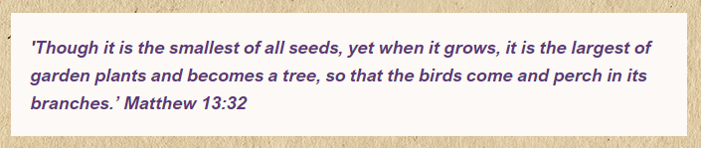
We are a small but ‘mighty’ school.
We deliver an active and engaging curriculum that challenges and inspires all, and encourages everyone to embrace 'life in all its fullness'.
Our emphasis is about learning to learn whilst promoting a Christian ethos.
We believe everyone can achieve!

Slide 9
Structure of the
Early Years Foundation Stage and Key Stage 1
Duckling Class
Miss Heather Cox – Class Teacher
Mrs Anna Wason -Teaching Assistant
Mrs Emma Gillette - Teaching Assistant

Slide 10
Early Years Foundation Stage Curriculum:
Clapham and Patching School follow the Early Years Foundation Stage Guidance which supports each child to take their next steps and follow their learning interests.
Our curriculum is play-based, filled with practical and fun experiences to support thinking and learning.

Slide 11
EYFS
Early Years Foundation Stage:
7 areas of learning:
Prime areas
Communication and Language
Personal, Social and Emotional Development
Physical Development
Specific areas
Literacy
Mathematics
Understanding the World
Expressive Arts and Design
Notes:
Summer Year 5 curriculum will be weaved throughout to address any gaps.
Methods taught in school may be different from home learning and tutoring.
Important to keep up mental arithmetic and understanding problems in different contexts.
Multi-step problems are always tricky.
Times tables – underpin most areas of maths

Slide 12
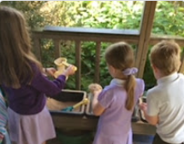
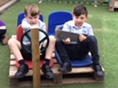
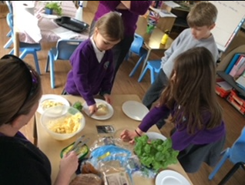
Communica:tion and Language
Communication and Language:
Interactions
Exploring language
Listening and Understanding
Notes:
Vocabulary is key – more ambitious, more independent with searching for new words.
High-level punctuation accurately used.
Children need opportunities at home for free writing, writing for purpose and for pleasure.
Handwriting – any practise at home, speed of writing, build up stamina for long pieces and joining is EXS
Editing and improving their work – biggest thing is spotting if it makes sense.
Targets
SPAG

Slide 13

Communication and Language:
How can you help?
Singing songs and nursery rhymes.
Taking time to listen to them, talking about
things they’ve done and answering their questions.
Talk to them about your day, sharing thoughts, ideas and jokes!
Use a wide range of vocabulary when talking with your child and encourage them to use it too eg. amazing, fabulous, incredible as alternatives for ‘good’.

Slide 14
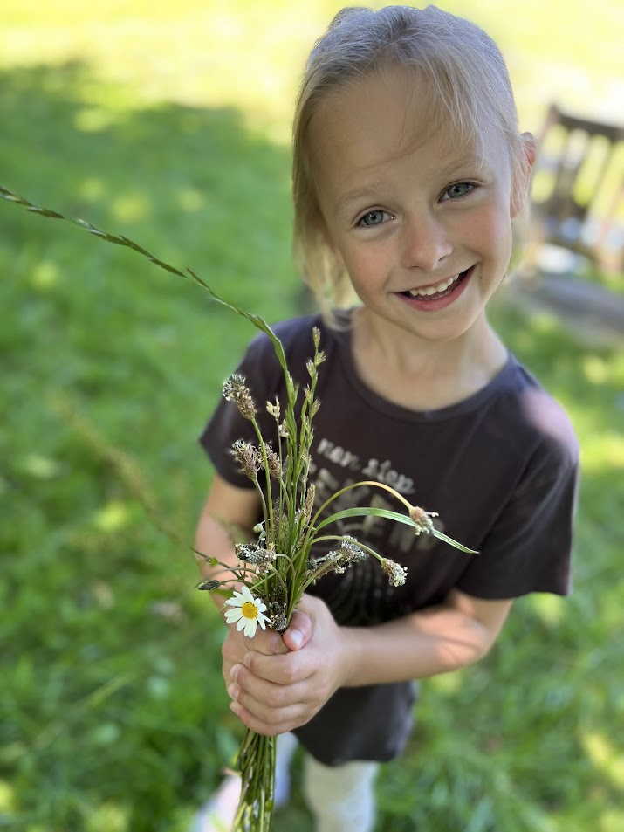
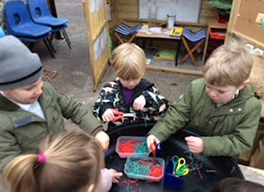
Personal, Social and Emotional Development:
Emotions
Sense of self
Relationships

Slide 15
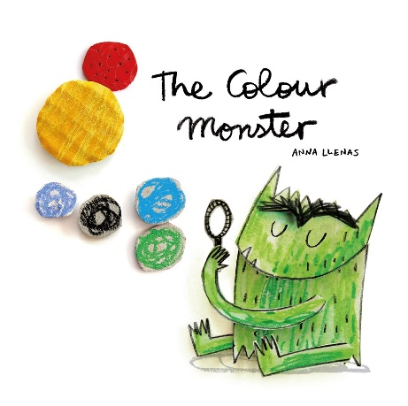
PSED: How can you help?
Talk about emotions.
Give your child small age appropriate responsibilities eg. tidy toys away, help set the table for tea…
Play games which encourage sharing and turn taking.
Arrange play dates with peers if possible.

Slide 16
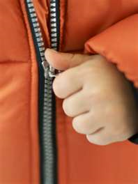
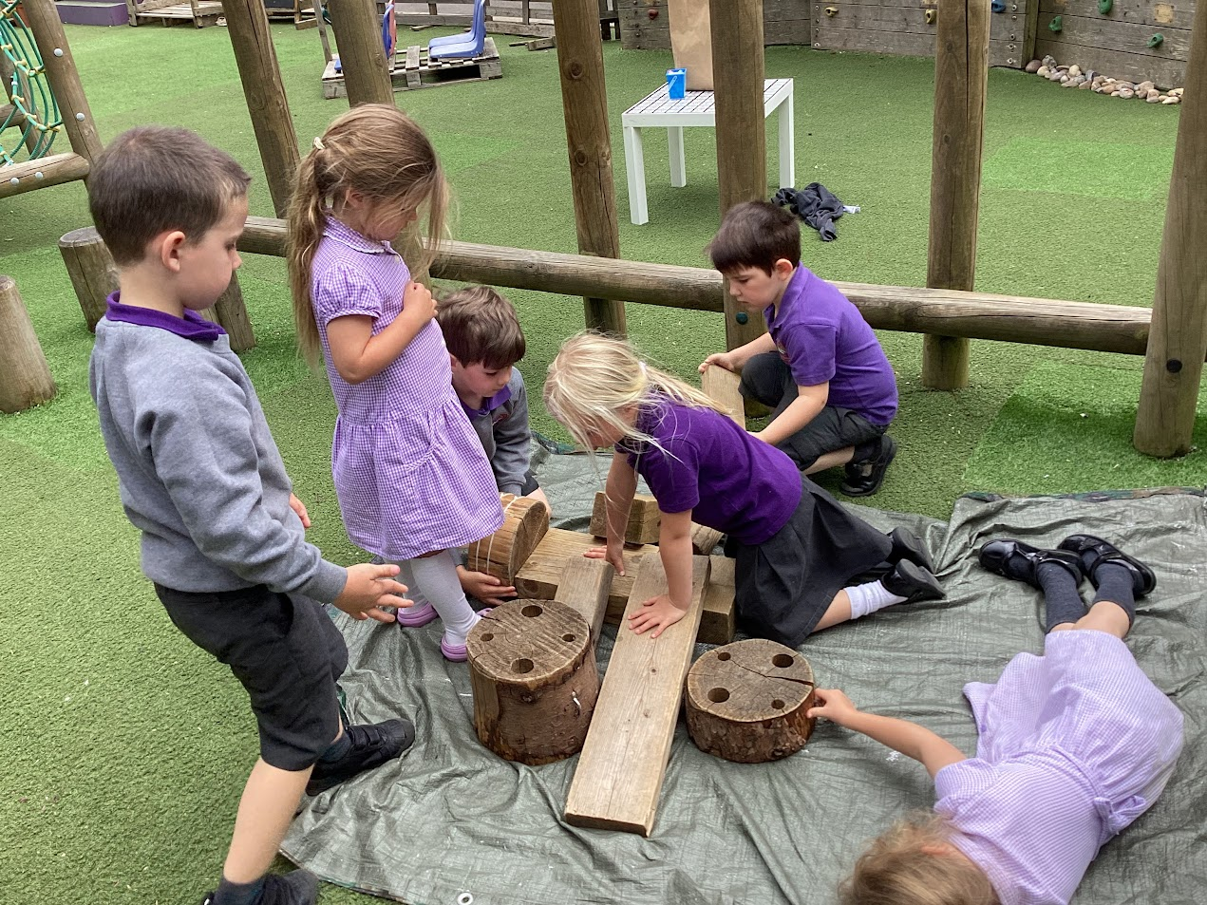
Physical Development:
Core strength and co-ordination
Gross motor skills
Fine motor skills

Slide 17
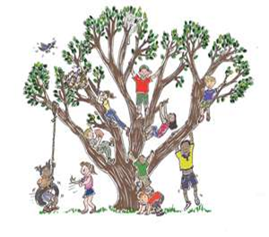
Physical Development:
How can you help?
Give children time to run,
jump, climb and play outdoors.
Encourage children in activities
such as building, drawing,
threading beads, or filling and
emptying water containers – all of which develop manipulative skills.
Provide opportunities to use a variety of tools including pencils, paintbrushes, garden tools, scissors, knives, forks and spoons.
Allow them to dress themselves and do up their own coat.

Slide 18
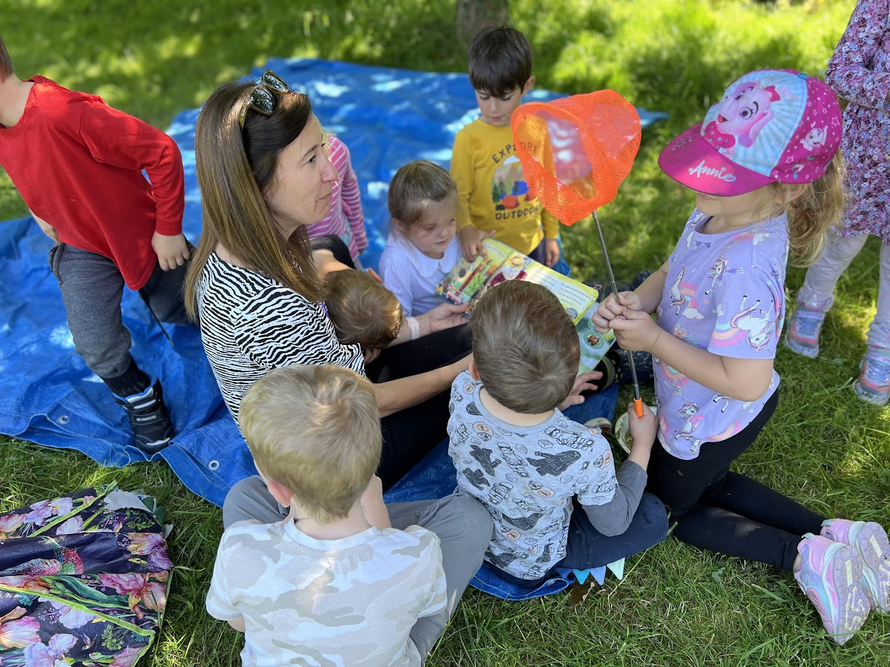
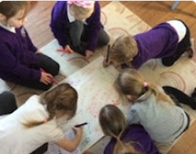
Literacy:
Reading Comprehension
Exploring words
Writing

Slide 19

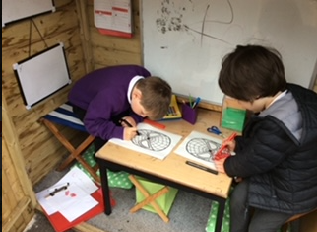
Literacy: How can you help?
Reading books (stories,
information books, newspapers,
magazines, comics etc),
encouraging your child to join in
and talk about books.
Play phonics games eg. ‘I spy with my little eye…’
Encourage mark making (eg. write a
shopping list, make labels)

Slide 20
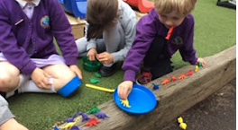
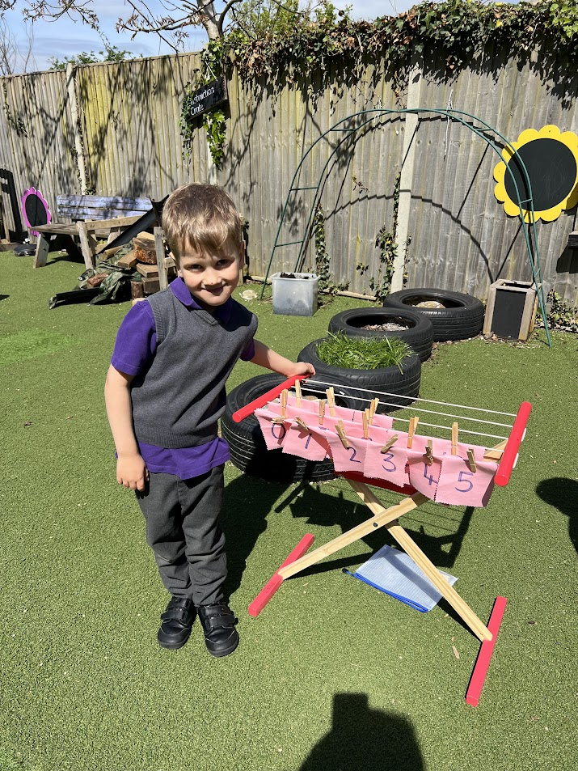
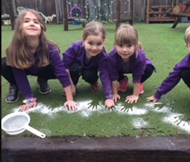
Mathematics:
Numbers
Patterns and connections
Spatial reasoning

Slide 21
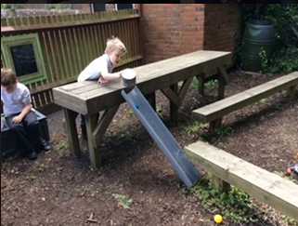
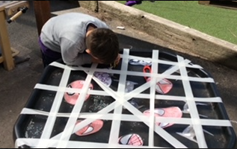
Mathematics: How can you help?
Talk about the shapes you can see in the environment.
Compare things which are
heavy/light, long/short, etc.
Pointing out numbers all around.
Singing counting songs and rhymes.
Counting, adding, subtracting,
Sorting and grouping anything and
everything - socks, cars,
shopping, cutlery, fingers and toes!

Slide 22
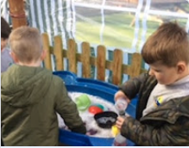
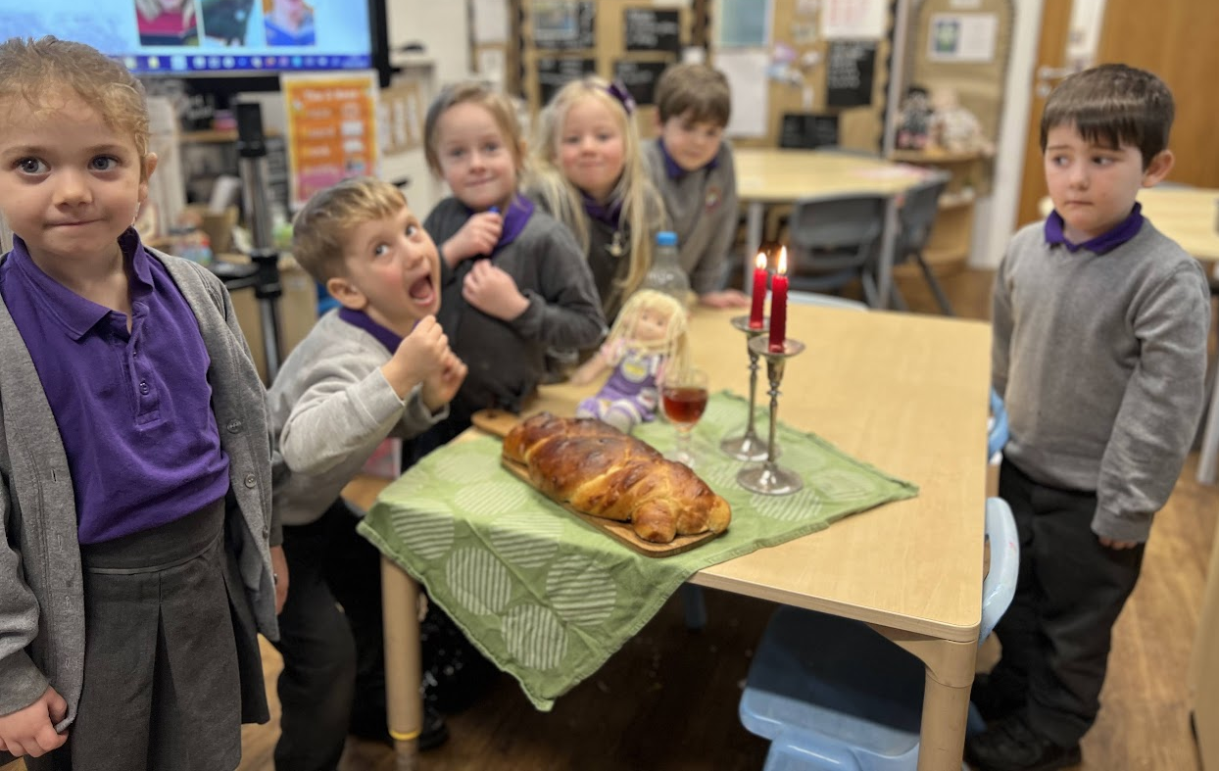
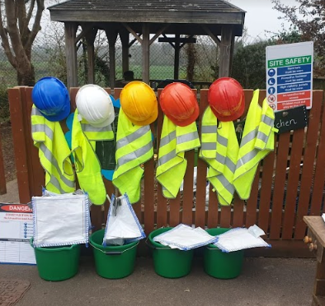
Understanding the World:
Personal experiences
Diverse world
Widening vocabulary

Slide 23
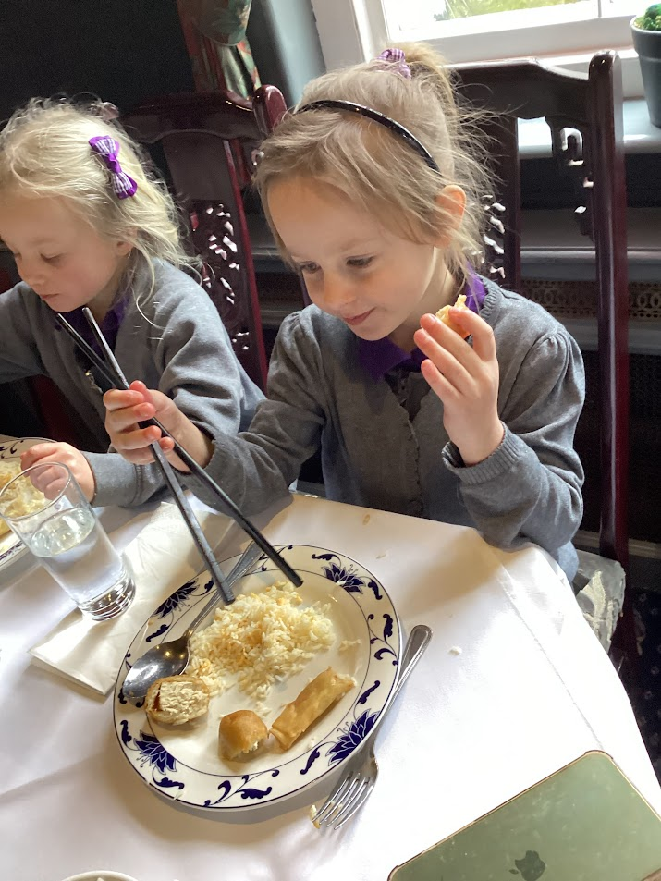
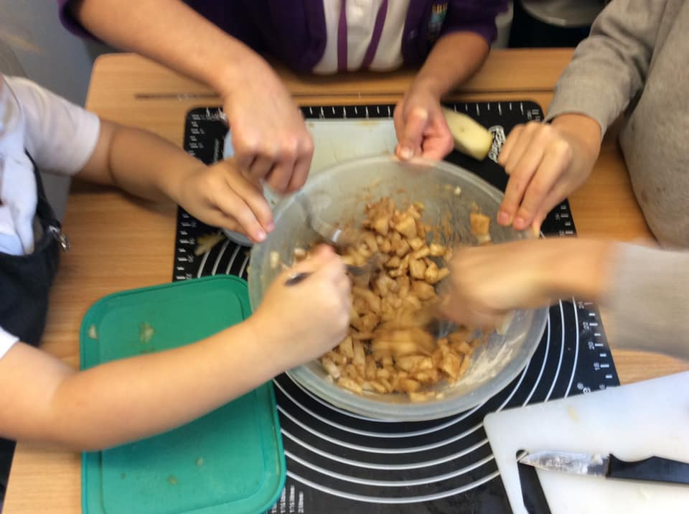
Understanding the World:
How can you help?
Talk with your child about the places they go and things they see in the world around them.
Answering and asking questions –
what if…?
Why do you think…? How did you…?
Encourage children to join in with
everyday activities - washing up,
cooking, shopping, helping in the
garden...

Slide 24
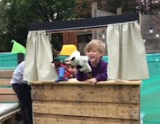
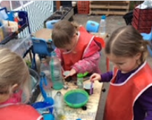
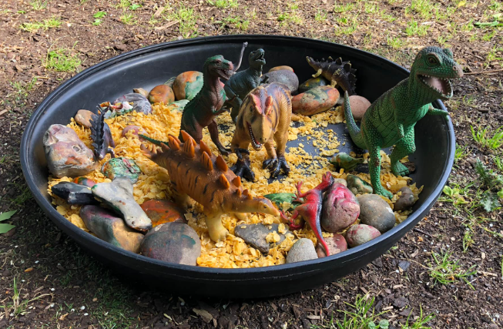
Expressive Arts and Design:
Imagination and creativity
Self expression
Communicating through arts

Slide 25
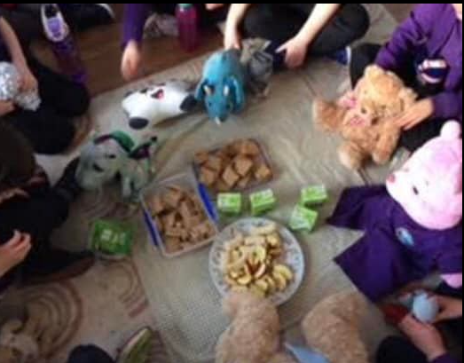
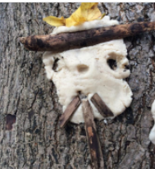
Expressive Arts and Design:
How can you help?
Talk with your child about
their imaginative play and
join in if possible!
Encourage them to be flexible
in their thinking and use of
materials.
Praise them for their efforts or ideas
As well as the end product.

Slide 26
A day in Duckling Class…
8.30 Gates open, children come in independently and put things away
8.30-8.50 Self-initiated play inside
9.00-9.20 Together time and phonics
9.20-11.40 Teacher led focus groups / self-initiated learning inside and outside
10:30 Healthy snack and milk time
11.40 Maths
12:00-1:00 Lunch time
1:00-1:10 Register and story time
1.15-2.40 1:1 Reading, teacher led focus groups /self-initiated learning
2.40-3.15 Collective worship/ Story and singing time
(3.15 please wait outside school to collect your child)

Slide 27
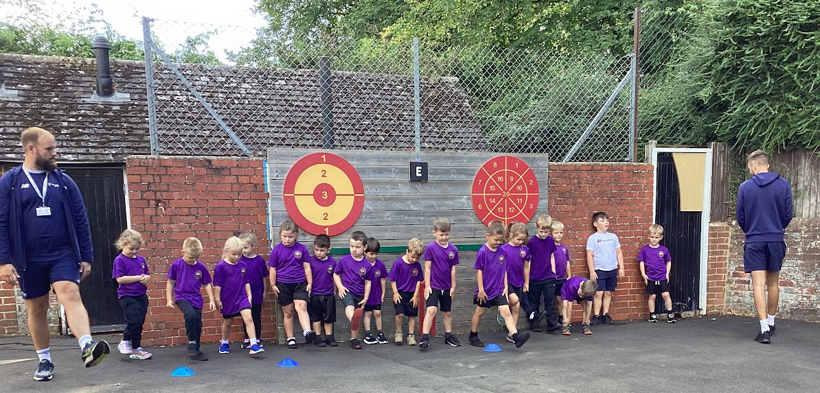
PE at Clapham and Patching:
Our PE day is Thursday.
Children keep their PE kit in school and get changed at school.

Slide 28


Phonics at Clapham and Patching:
We have chosen to use the Little Wandle Letters and Sounds for our phonic teaching.
There will be a parent workshop at the start of next term for more information.

Slide 29

Assessment at Clapham and Patching:
When we have got to know your children a bit better, they will participate in the Reception baseline assessment.
We will use the Tapestry online Learning Journal and a Learning Journal in school, throughout the year, to make observations on progress.
We will send details of how to log on in September.

Slide 30
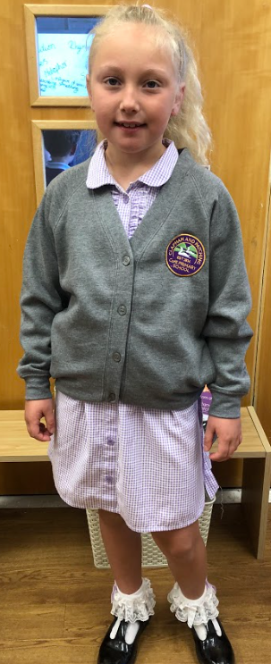
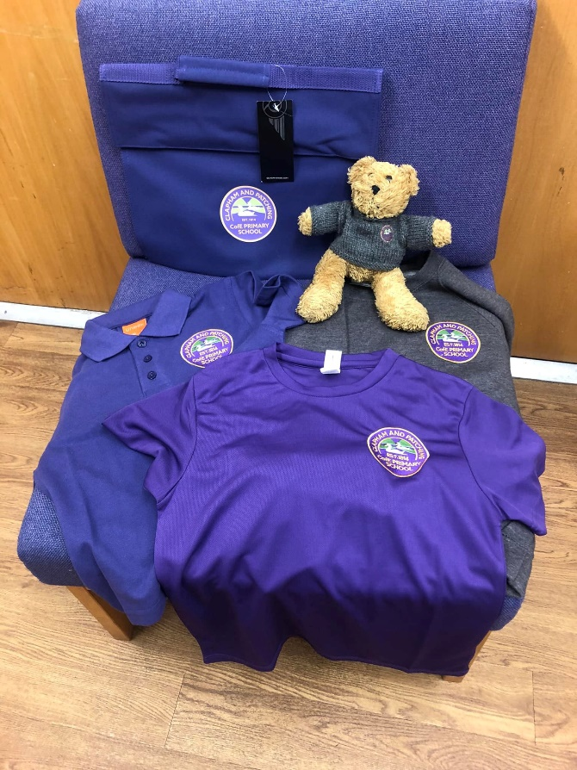
School Uniform:
School Uniform
Available from Broadwater Sports

Slide 31
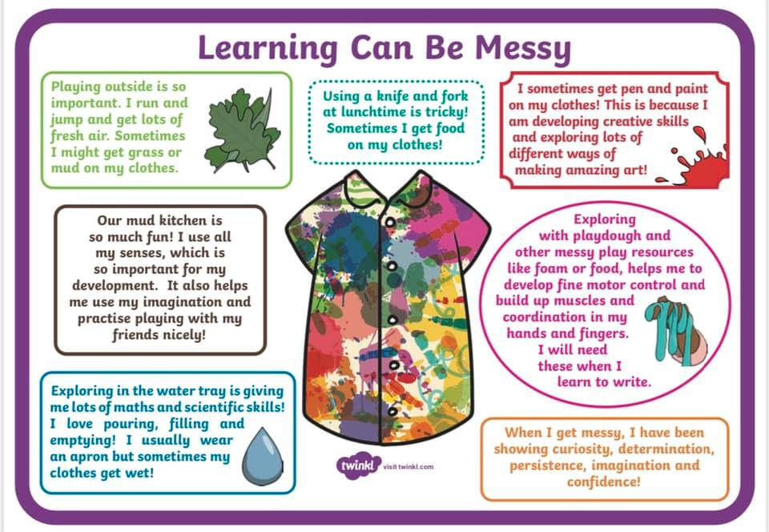

Slide 32
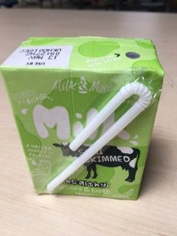
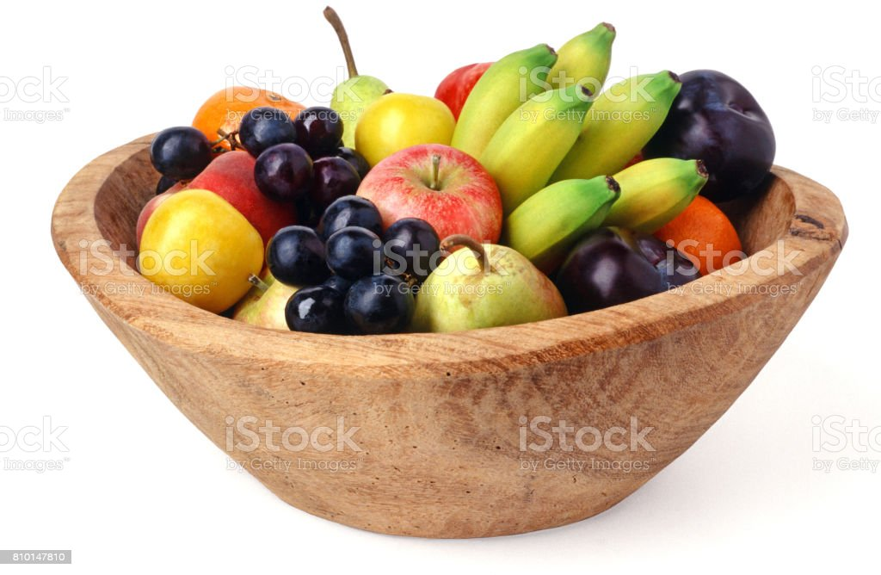
Snack time:
Everyday we have a selection of fruit available for snack time.
You may want to send in a healthy snack that you know your child will eat as well. Please put it in a named pot.
Milk is free and
available to all
children under
5 years old.

Slide 33

Lunch time:
Free school meals are available, for all children in Reception and Years 1 and 2, from Chartwells.
Or you can provide a packed lunch.
As a parent, you will select the meals for your children via ParentPay. The Office will set you up with a login ready for September.
After lunch, there is a playtime on
the playground or the village recreation area and an opportunity to walk the Wild Mile.

Slide 34


What do I need to bring?
All named please!
School uniform
Bag with a change of clothes
Welly boots
Water bottle
Coat
Healthy snack –fruit/crackers/rice cake

Slide 35
What next?
Summer Term
Teddy bear’s picnic Wednesday 3rd July 2024 3:30 – 4.15pm
We will be in touch with your pre-schools and nurseries to hand over information
Autumn Term
Home visits TBC
Start date is Wednesday 4th September (full details of timings are in your new starter packs)

Slide 36
If you have any questions, do contact the school office 01903 871214 or office@claphamandpatching.co.uk

